Slide 1
Recitation 4: Learning objectives
How to conduct a one and two-sample t-test using the t.test(...) function in R AND understand the model outputs.
How to calculate confidence intervals of your parameter estimates, e.g. sample means.
How to create barplots with error bars.

Slide 2

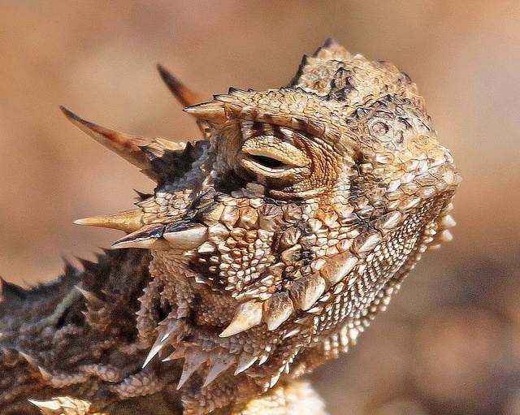
Warmup exercise
Download “Lizards.csv” data from Trunk, and read csv file into R.
Calculate mean, standard deviation, variance, range, and standard error of horn length (mm) of live vs. killed horned lizards.
Plot a histogram of horn length (mm) of live vs. killed horned lizards.

Slide 3
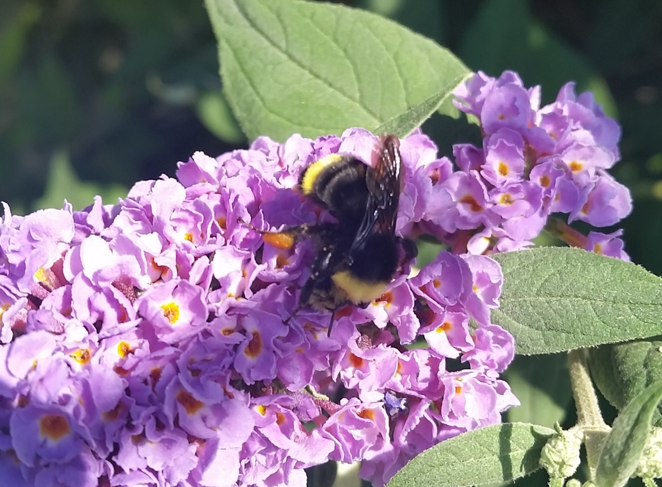
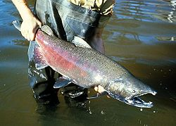
See handout for exercises
Exercise 1: Biologists at Tufts and UC Davis were interested in whether worker size varies significantly among colonies in the yellow faced bumble bee (Bombus vosnesenskii, pictured). Bumble bee workers can vary up to 10-fold in mass and they exhibit a phenomenon called size polyethism, where task allocation is determined based on worker size.
Exercise 2: Biologists were interested in whether brook trout (native to Eastern North America) that were introduced to the Pacific Northwest affects the survival of the native chinook salmon (pictured).

